Slide 1
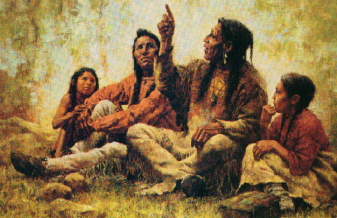
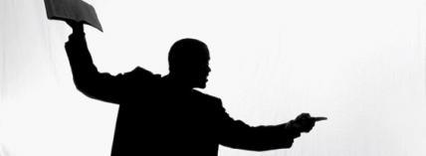
Preaching, Narrartive, and Storytelling
Session Four: Methods and Practices

Slide 2
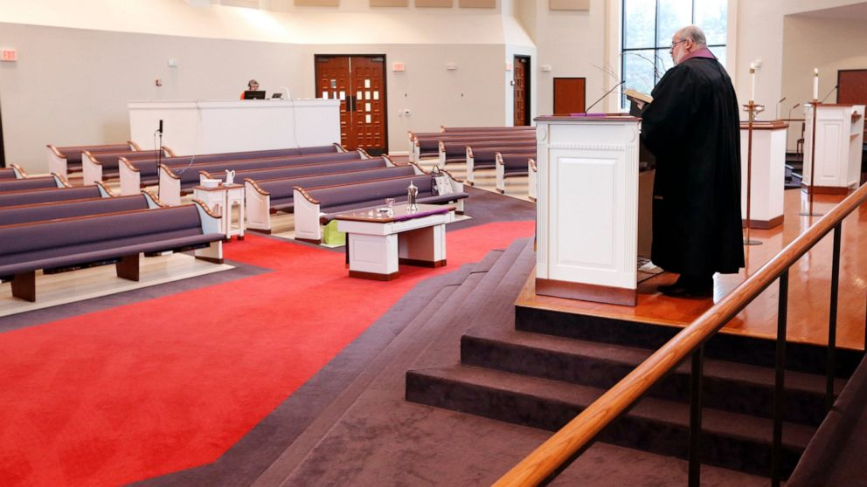
How do you measure if a sermon or talk “worked?”

Slide 3

What makes a sermon “work?”
“When the door opens in a sermon, it is because God has consented to be present. Sometimes it happens and sometimes it doesn’t. When it does, there is no mistaking it. Fresh air pours into a stale room. Light crowds out all shadows. When it doesn’t, that may have as much to do with our own failure to be present as with God’s.
Some preachers will pound away at a sermon without ever finding the handle to it, and some congregations will sit and stare at an open door without ever walking through it, but even our incompetence cannot shut God out for long. The living word of God is more able that we are. If we will remain with it, it will heal us, because God is in it.” - Barbara Brown Taylor, 85

Slide 4
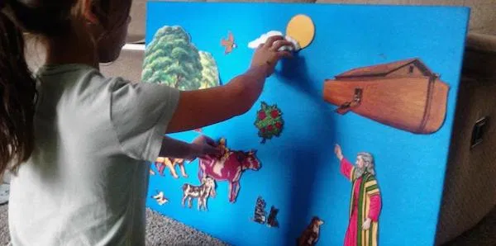
Homework:
3-minute lessons: How do we know God is with us?
  What was the main point?
  What made it memorable?
  Any obstacles to engaging?

Slide 5
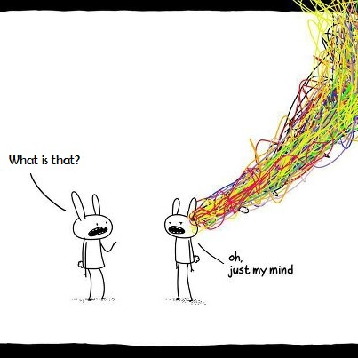
Exercise: Preparation
How do you prepare to give a talk/preach?

Slide 6
Average time spent on sermon preparation
Median: 13 hours
Churchleaders.com

Slide 8
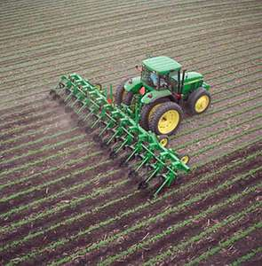
Preparation
Matthew 4: Jesus was led by the Spirit into the wilderness for 40 days before he began to preach and teach.
Three temptations of Jesus (paradigms to avoid in ministry) paraphrased by E. Peterson:
  Respond to all needs: dealing with people (and ourselves) as consumers
  Embark on a circus career in miracles: making sure people are not bored, entertainment-based
  Take charge: emphasizing getting things done and doing them right over cultivating relationships
“Unlike raw facts, truth, especially personal truth, requires the cultivation of unhurried intimacies.” – Eugene Peterson, Tell It Slant, 4.
  Cultivation: takes some practice, repetition, metaphor of turning over the soil
  Unhurried: giving breathing room, time to grow, trusting the work of the Spirit more than our words and ideas
  Intimacy: with Jesus, with people, with the message we are trying to proclaim, with ourselves

Slide 9
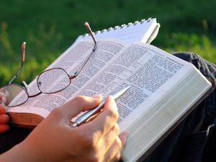
Routine for preparing a Sermon
Barbara Brown Taylor
1. Sitting with the text
“Every preacher has a different routine for preparing a sermon. My own begins with a long sitting spell with an open Bible on my lap, as I read and read and read the text. What I am hunting for is the God in it, God for me and for my congregation at this particular moment in time. I am waiting to be addressed by the text by my own name, to be called out by it so that I look back at my human situation and see it from a new perspective, one that is more like God’s. ... I am not in control of the process. It is a process of discovery, in which I run the charged rod of God’s word over the body of my own experience and wait to see where the sparks will fly. … This means that I never know ahead of time what I will preach. If I did, then my sermons would be little more than lessons, expositions of things I already know that I think my listeners ought to know too. While there are preachers who do this sort of thing well, I am not one of them. I do not want to scatter pearls of wisdom from the pulpit; I want to discover something fresh – even if I cannot identify it yet, even if it is still covered with twigs and mud. I want to haul it into the pulpit and show others what God has shown me, while I am still shaking with excitement and delight.” (BBT, 85-6)

Slide 10

Routine for preparing a Sermon
Barbara Brown Taylor
2. Doing the work of discovery
“The process of discovery begins with the text. Whether I like it or not, I approach it believing that God is in it and I commence the long, careful discipline of panning for gold. There are translations to be compared, words to be studied and puzzles to be solved. What is a corban? How much is a talent? Where was Emmaus? More important, what did this passage mean to the one who first wrote it down? I am not free to pluck it out and use it in my own design. It has its own integrity. It is part of someone else’s design, and the respectful preacher will work to discern its original meaning before imposing any other on it.” (BBT, 86)

Slide 11
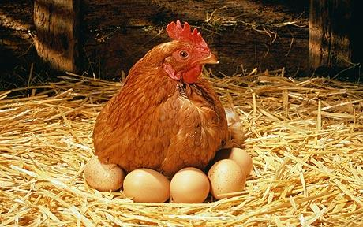
Routine for preparing a Sermon
Barbara Brown Taylor
3. Letting it Gestate
“Once I have done all my homework and have a decent idea what the text means, I give it a rest. Understanding is not enough. I do not want to pass on knowledge from the pulpit; I want to take part in an experience of God’s living word, and that calls for a different kind of research. It is time to tuck the text into the pocket of my heart and walk around with it inside of me. It is time to turn its words and images loose on the events of my everyday life and see how they mix. … This is the gestation period of a sermon, and it cannot be rushed. It is a time of patient and impatient waiting for the stirring of the Holy Spirit, that bright bird upon whose brooding the sermon depends. Over and over again I check the nest of my notes and outlines, searching through them for some sign of life. I scan the text one more time and all of a sudden there is an egg in plain view, something where there had been nothing just a moment before, and the sermon is born. What the egg contains is a connection, a likeness, between the life of the text and the life of the world.” (BBT, 87)

Slide 12

Routine for preparing a Sermon
Barbara Brown Taylor
4. Being Attuned to God’s Presence
“All the parts of preaching can be taught: exegesis, language, metaphor, development, delivery. What is hard to teach is how to put them all together, so that what is true is also beautiful, and evocative, and alive. Life itself is the best teacher. Preachers who are attuned to God’s presence and movement in the world do not have to invent much. All we have to learn is how to say what we see.” (BBT, 89)
“With any luck, where the sermon finally leads both preacher and congregation is into the presence of God, a place that cannot be explained but only experienced. When a sermon like this is over, it is not over. Everyone involved in it goes away with images, thoughts, and emotions that change and grow as the process of discovery goes on and on and on.” (BBT, 89)

Slide 13

Who creates a sermon?
“I believe every sermon begins and ends with God. Because the word of God is what a preacher wrestles with in the pulpit, and because it is a living word, every sermon is God’s creation as well as the creation of the preacher and the congregation. All three participate in the making of it, with the preacher as their designated voice.
It is a delicate job for the one in the pulpit, a balancing act between the text, the congregation and the self. If the preacher leans too far one way, he will side with the text against the congregation and deliver a finger-pointing sermon from on high. If the preacher leans too far the other way, she will side with the congregation against the text and deliver a sermon that stops short of encountering God.
What is called for, instead, is a sermon that honors all of its participants, in which preachers speak in their own voices out of their own experience, addressing God on the congregation’s behalf and – with great care and humility – the congregation on God’s behalf.” - Barbara Brown Taylor, 82-83

Slide 14
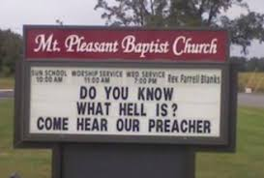
Preaching pitfalls
Introducing problem so you can solve it (you are going to hell)
Inciting fear, guilt, uncertainty just so you can alleviate it (are you giving enough?)
Bait and switch: say you are going to do one thing and do another (how to get your prayers answered; send me money)
Preaching about a problem instead of dealing directly with the person involved (a person has criticized me so I will speak about respecting authority)
Us/them or insider/outsider talk (watch out for those dangerous people who go to public demonstrations)
Overstating things or talking down to people: everyone knows, it is obvious that, the Bible clearly states, no one believes that, etc.

Slide 15
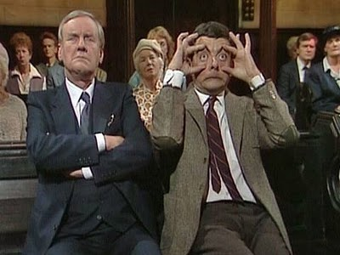
A few things to consider…
If you are overly self-conscious, you will have a harder time being Holy Spirit-conscious and other-conscious.
Be okay with not knowing things, not presenting final ideas. Ask people to consider things together with you, grapple with struggles together, invite them into the journey.
Change up the pace:
  Give listeners a chance to reflect, to consider, disagree, or question
  Give yourself a chance to notice how people are responding
The hardest parts of a sermon are the beginning and the ending
  Beginning: connect with people, arouse curiosity, overcome passivity, fatigue, etc., recognize anxiety, worries, etc.
  Ending: what do you want people to remember? What might the Holy Spirit be inviting people to?

Slide 16

Paradigm of preaching
Prayer: “This makes preaching a form of prayer for me, an act of conscious self-offering in which I stand exposed before God and my neighbor, seeking relationship with them both.” (BBT, 89)
Placing ourselves in God’s hands: “The success or failure of any particular sermon seems less important to me than the ongoing process of placing myself in God’s hands.” (BBT, 90)
Gift: Every time I speak, I ask God, “What gift would you have me give these precious ones?” Preaching and teaching put me in the middle of a gift extravaganza. God is giving Godself to us as we gather. I am giving who I am and what I know. People are giving their attention, their responses, their questions. When all parties are truly present, giving and receiving flow into each other and all are enriched.

Slide 17
Exercise
What is your paradigm for preaching/teaching? (feeding people, comfort, challenge, encounter, etc.)
  What questions are you asking yourself as you prepare?
  What questions do you ask yourself after you have finished?
What is a recurring message in your talks? (e.g. justice, encounter, Jesus as central, community, worship, pilgrimage, hope, etc.)

Slide 18
Reading the Scriptures
What is your experience of listening to Scriptures being read aloud?
What is your experience of reading the Scriptures aloud to a group?

Slide 19
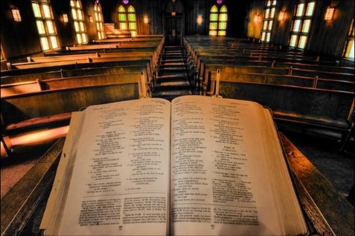
“In most church services the reading of the Word is poorly and hurriedly done. What a missed opportunity! The public reading of God’s Word is an interpretive act that takes skill and thought and has historically been understood as means of grace equal with preaching and sacraments.” – Tim Keller

Slide 20
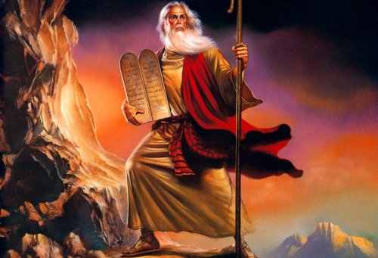
Reading the Scriptures (a brief history)
Moses gathers the people together at Mt. Sinai and read the words given by God. They reminded the people where they came from, who they were, the new future they were called to
Oral culture: telling a collective history, part of a collective journey (Deut. 31:11)
When Israelites arrived in the Promised Land, Joshua read the sacred words to them
Public reading of sacred texts not mentioned for several centuries
Centuries later, Josiah rediscovered the Scriptures and called the people together to have them read aloud
Public reading of Scripture waned again, and the public reading of the sacred texts again associated with people returning to God (Neh. 8:1,8)

Slide 21
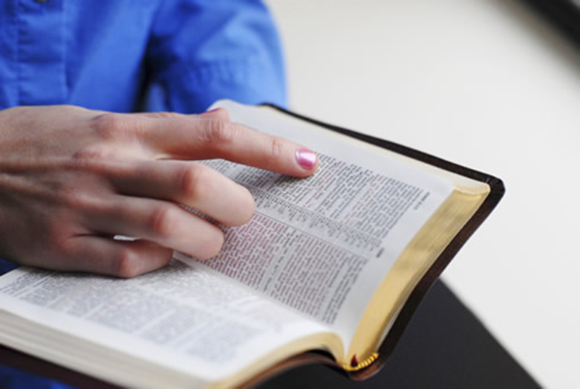
Reading the Scriptures in the Church
Weekly readings in the synagogue (Luke 4:18-19)
Letters of apostles read aloud to the churches (Col. 4:16)
Before the printing press, most people encountered the Bible through public reading
Today, reading the Bible is considered more a silent, private activity, less a communal, oral event

Slide 22
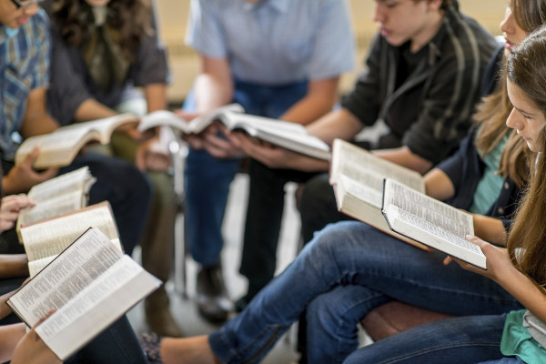
Why is it important to read the Scriptures together?

Slide 23
Isaiah 40:1-5
Common English Bible
Comfort, comfort my people! says your God.
Speak compassionately to Jerusalem,
and proclaim to her that her compulsory service has ended,
that her penalty has been paid,
that she has received from the Lord’s hand double for all her sins!
A voice is crying out: “Clear the Lord’s way in the desert!
Make a level highway in the wilderness for our God!
Every valley will be raised up,
and every mountain and hill will be flattened.
Uneven ground will become level,
and rough terrain a valley plain.
The Lord’s glory will appear,
and all humanity will see it together;
the Lord’s mouth has commanded it.”

Slide 24
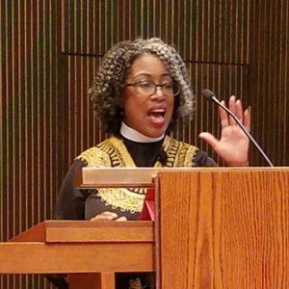
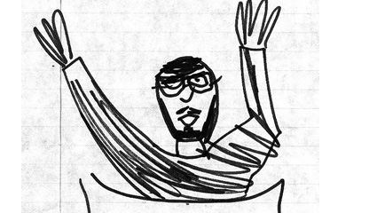
Questions
Feedback on course:
What were the points that resonated with you?
What made them memorable?
What were the obstacles to engaging?

